Slide 1
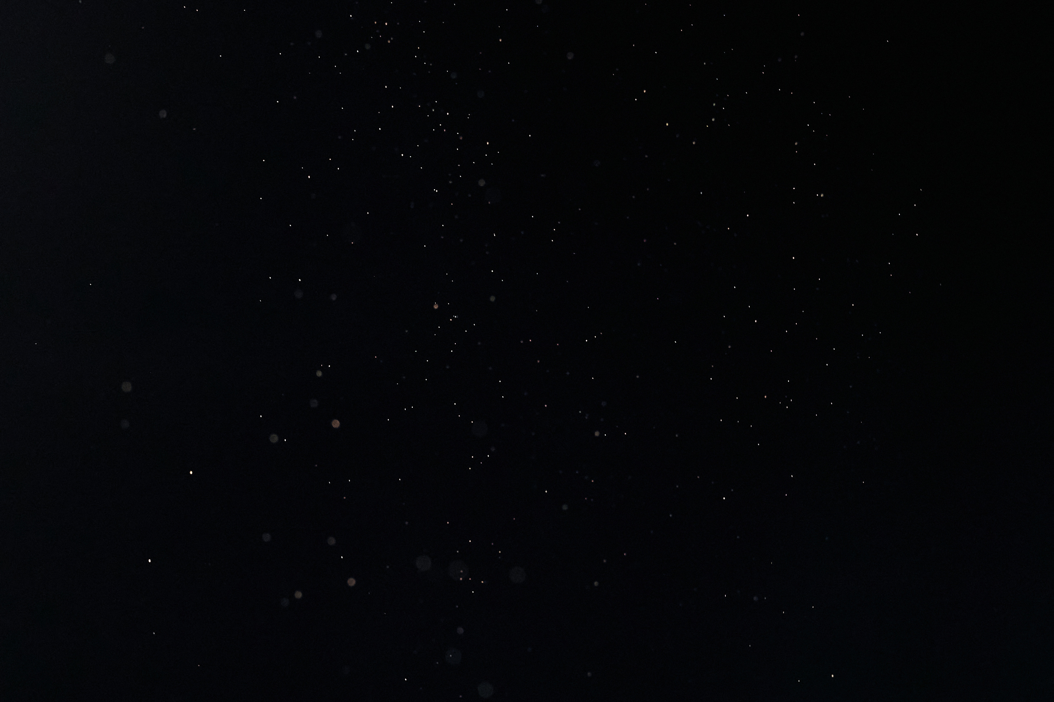

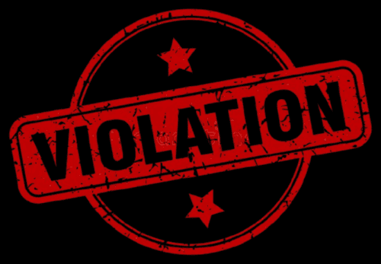

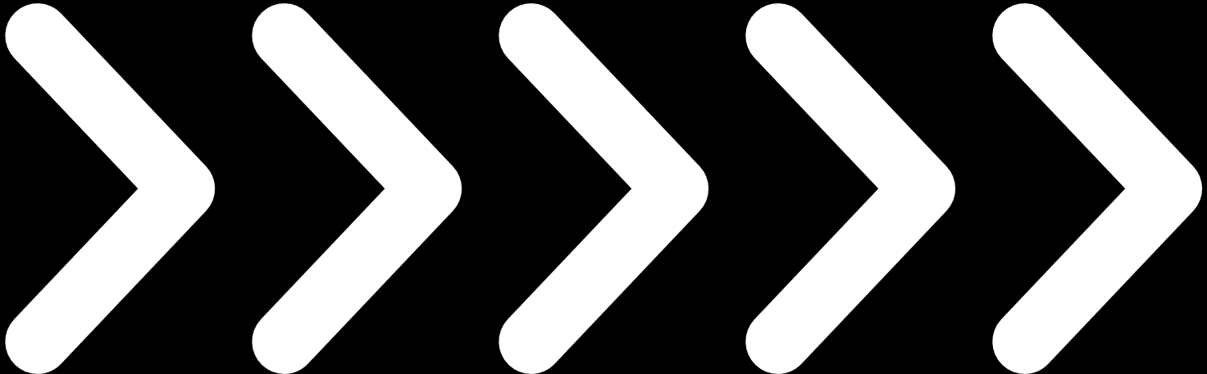
STUDENT VIOLATION SYSTEM

Slide 2
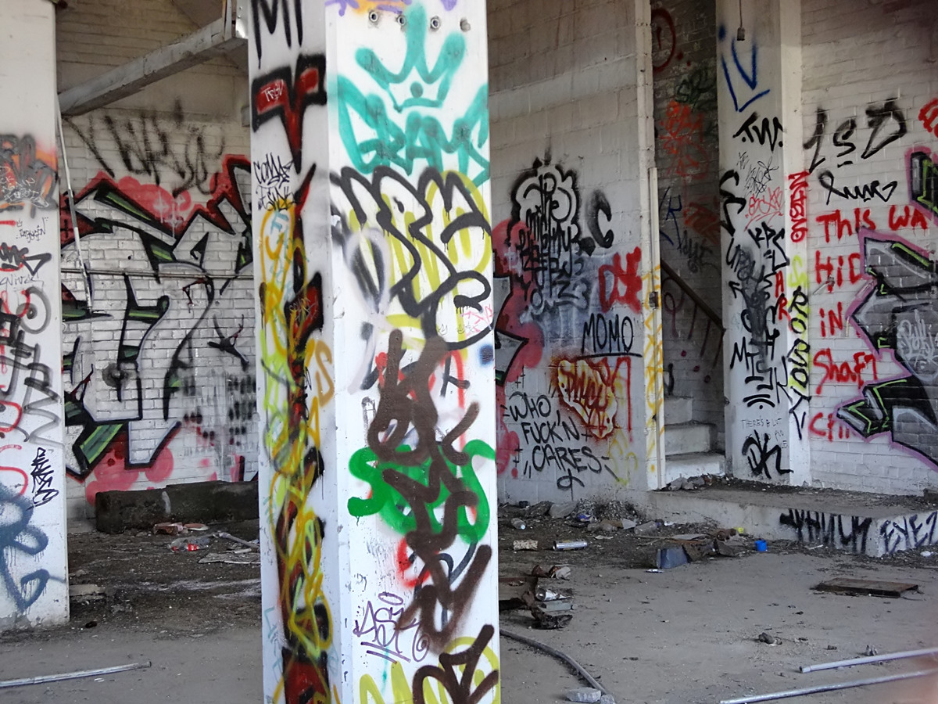
Introduction
The Student Violation System is a computerized platform designed to monitor, record, and manage student violations within a school or academic institution. This system streamlines the process of tracking disciplinary actions, promoting transparency, consistency, and accountability among students and staff.

Slide 3
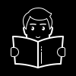
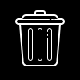
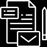
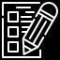
Main Features
Create
Read
Update
Delete
In which it allows users to add
violation of a student.
In which it displayed the detailed list of violation of the students.
In which the user can edit a particular Record of the Students and the Violation when the Record is being UPDATED.
The User can delete a particular records.

Slide 4
BENEFACTORS

Slide 5

Guidance Counselor
/Admin
They benefit from easier tracking and updating of student violations, as well as generating and even printing reports for counseling or disciplinary hearings.

Slide 6

Teachers/User
Teachers can quickly record student violations and coordinate with guidance counselors or administrators, saving time and ensuring that proper action is taken.

Slide 7

Students
- Subject of the violation
Students gain a better understanding of the consequences of their actions, which helps promote accountability, encourages good behavior, and provides opportunities for personal growth.

Slide 8
ENTITY RELATIONSHIP DIAGRAM (ERD)

Slide 9
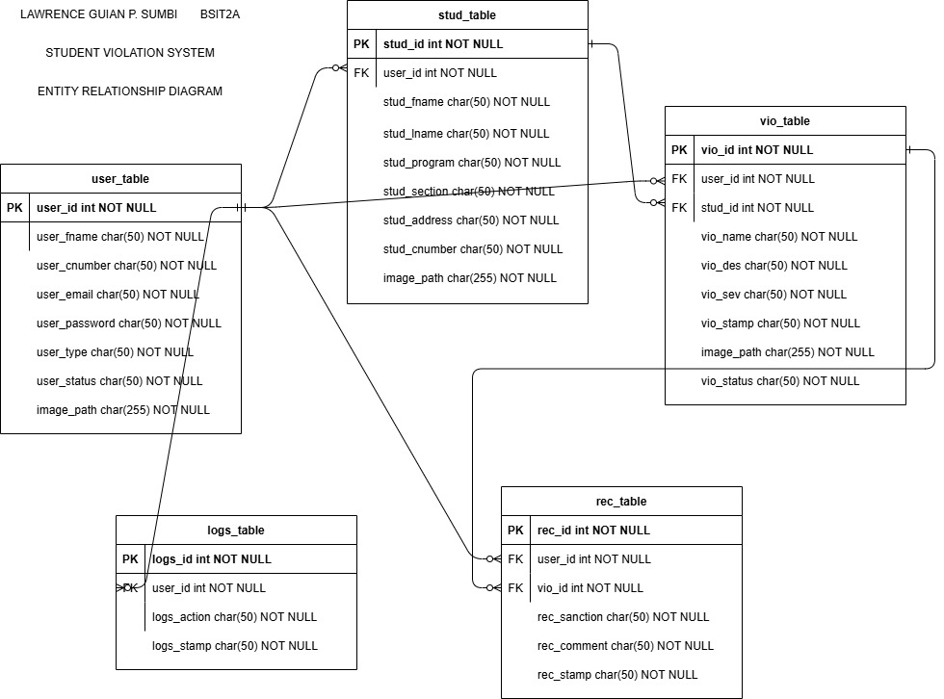

Slide 10
FLOWCHART

Slide 11
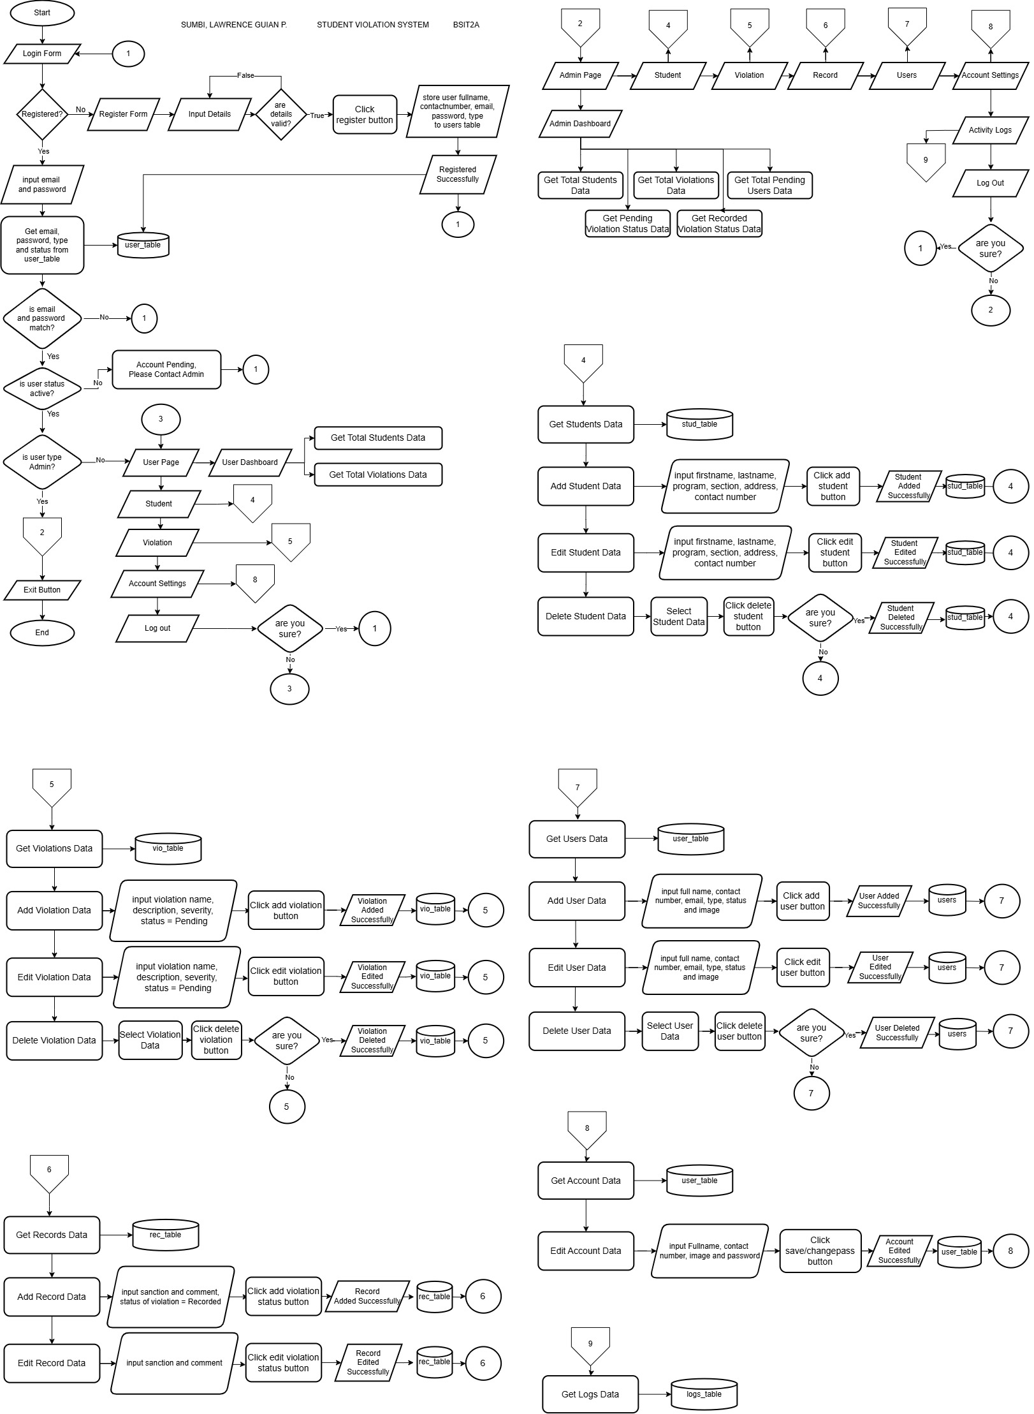

Slide 13
THANK YOU

